Slide 1
Chapter 3
The Data Link Layer

Slide 2
Questions for you
Why is Cellular Network called cellular?
Major differences among 1G, 2G, 3G, 4G, 5G
How satellite transmits data?

Slide 3
Data Link Layer Design Issues (1 of 2)
Network layer services
Framing
Error control
Flow control

Slide 4
Data Link Later Functions
Providing a well-defined service interface to the network layer.
Framing sequences of bytes as self-contained segments.
Detecting and correcting transmission errors.
Regulating the flow of data so that slow receivers are not swamped by fast senders.

Slide 5
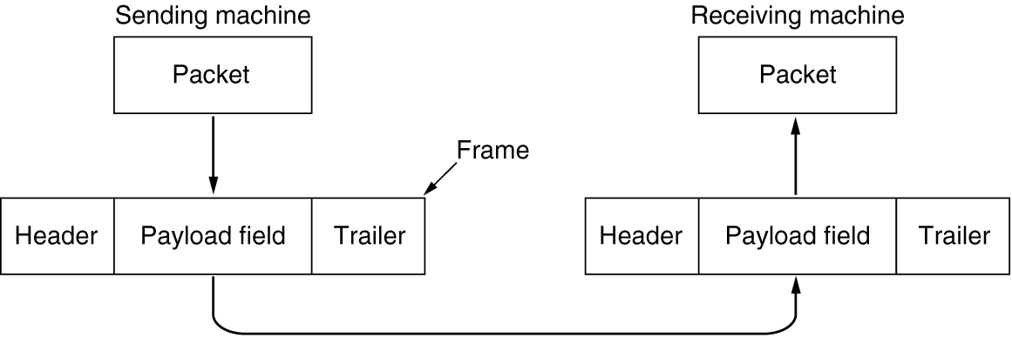
Data Link Layer Design Issues (2 of 2)
Relationship between packets and frames

Slide 6
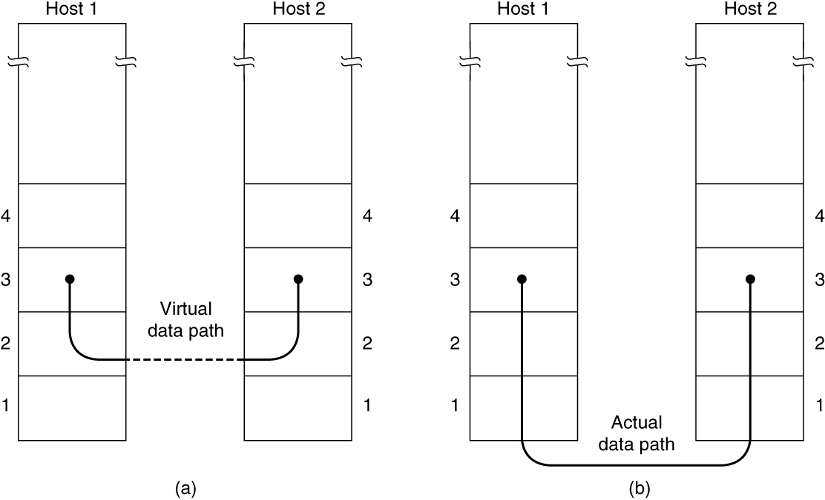
Services Provided to The Network Layer (1 of 2)
(a) Virtual communication. (b) Actual communication.

Slide 7
Services Provided to The Network Layer (2 of 2)
Actual services vary from protocol to protocol
Three possible services
Unacknowledged connectionless service
Acknowledged connectionless service
Acknowledged connection-oriented service

Slide 8
Framing (1 of 4)
Framing methods
Byte count
Flag bytes with byte stuffing
Flag bits with bit stuffing
Physical layer coding violations

Slide 9
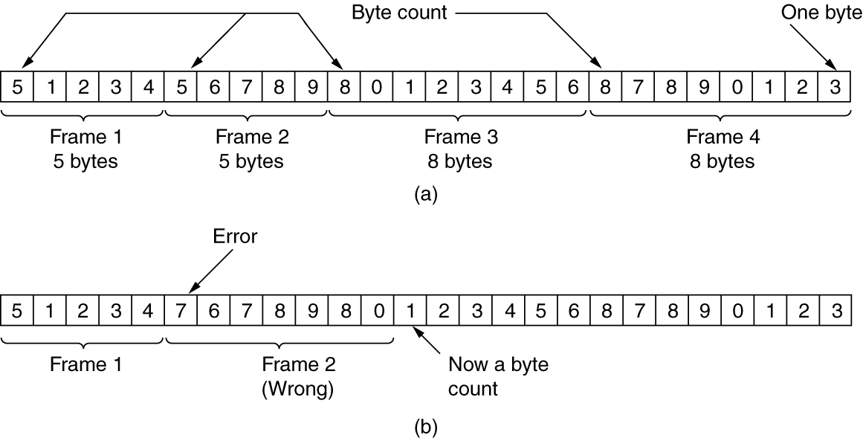
Framing (2 of 4)
A byte stream. (a) Without errors. (b) With one error.

Slide 10
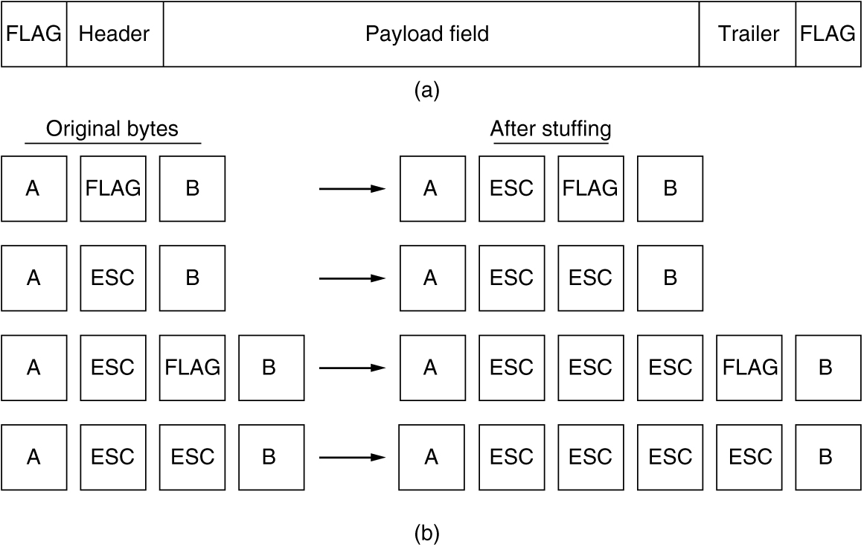
Framing (3 of 4)
(a) A frame delimited by flag bytes. (b) Four examples of byte sequences before and after byte stuffing.

Slide 11
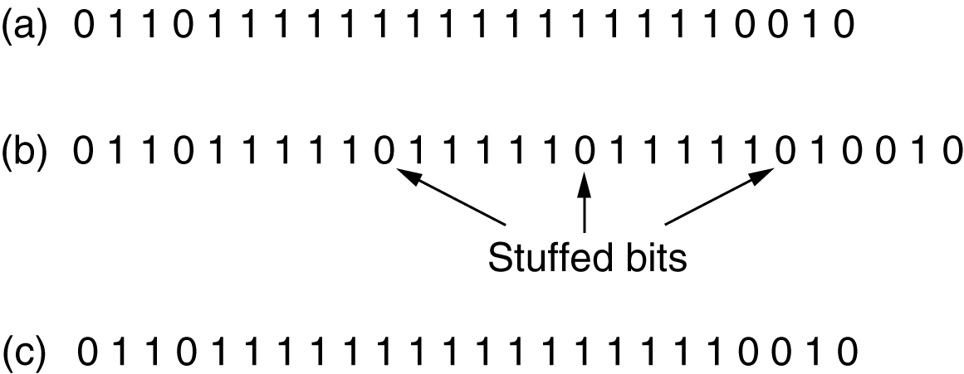
Framing (4 of 4)
Bit stuffing. (a) The original data. (b) The data as they appear on the line. (c) The data as they are stored in the receiver’s memory after destuffing.

Slide 12
Error Control
Ensuring all frames are eventually delivered:
To the network layer at the destination
In the proper order
Ensures reliable, connection-oriented service
Requires acknowledgement frames and timers

Slide 13
Flow Control
Controlling the sending of transmission frames at a faster pace than they can be accepted
Feedback-based flow control
Receiver sends back information to the sender giving it permission to send more data
Or receiver tells the sender how the receiver is doing
Rate-based flow control
Protocol has a built-in mechanism
Mechanism limits the rate at which senders may transmit data
No feedback from the receiver is necessary

Slide 14
Error Detection and Correction
Error-correcting codes
Referred to as FEC (Forward Error Correction)
Include enough redundant information to enable the receiver to deduce what the transmitted data must have been
Error-detecting codes
Include only enough redundancy to allow the receiver to deduce that an error has occurred (but not which error) and have it request a retransmission
Key consideration is the type of errors likely to occur

Slide 15
Error-Correcting Codes (1 of 4)
Hamming codes
Binary convolutional codes
Reed-Solomon codes
Low-Density Parity Check codes

Slide 16
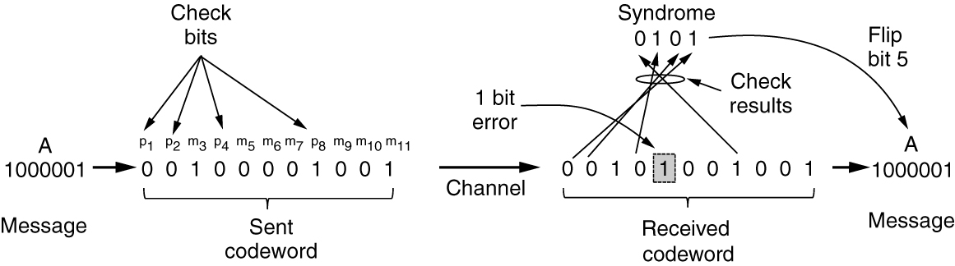
Error-Correcting Codes (2 of 4)
Example of an (11, 7) Hamming code correcting a single-bit error

Slide 17
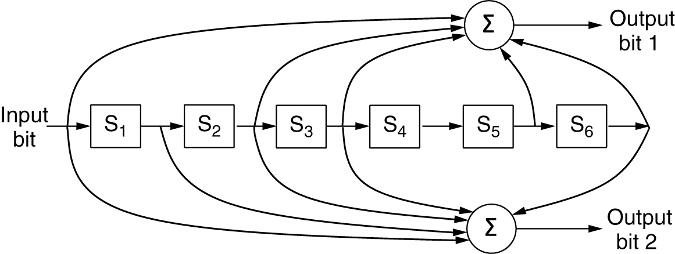
Error-Correcting Codes (3 of 4)
The NASA binary convolutional code used in 802.11
The encoder has memory!

Slide 18
Error-Correcting Codes (4 of 4)
Reed-Solomon codes
Linear block codes
Often systematic
Codes are based on the fact that every n degree polynomial is uniquely determined by n + 1 points
LDPC (Low-Density Parity Check) codes
Linear block codes
Each output bit is formed from only a fraction of the input bits
Practical for large block sizes
Have excellent error-correction abilities that outperform many other codes

Slide 19
Questions for you
Difference between packet and frame
Error control and flow control
Framing methods
Byte count
Flag bytes with byte stuffing
Flag bits with bit stuffing
Physical layer coding violations

Slide 20
Error-Detecting Codes (1 of 3)
Linear, systematic block codes
Parity
Checksums
Cyclic Redundancy Checks (CRCs)

Slide 21
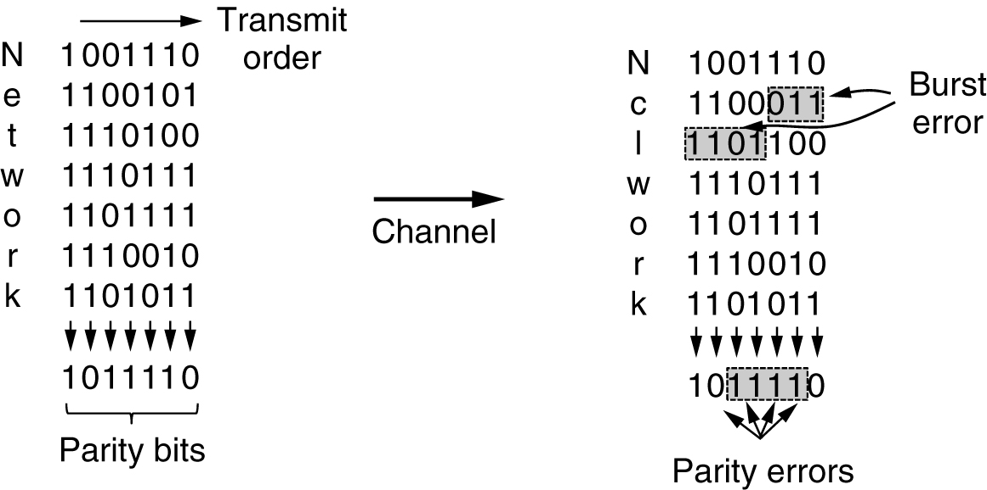
Error-Detecting Codes (2 of 3)
Interleaving of parity bits to detect a burst error

Slide 22
Error-Detecting Codes (3 of 3)
The word “checksum” is often used to mean a group of check bits associated with a message, regardless of how the bits are calculated.
A group of parity bits is one example of a checksum.
Stronger checksums based on a running sum of the data bits of the message.
The checksum is usually placed at the end of the message, as the complement of the sum function.

Slide 23
Error-Detecting Codes (3 of 3)
A third and stronger kind of error-detecting code is in widespread use at the link layer: the CRC (Cyclic Redundancy Check), also known as a polynomial code.
Polynomial codes are based upon treating bit strings as representations of polynomials with coefficients of 0 and 1 only.
Example calculation of the CRC

Slide 24
Elementary Data Link Protocols
Assumptions underly the communication model
Three simplex link-layer protocols
Utopia: No Flow Control or Error Correction
Adding Flow Control: Stop-and-Wait
Adding Error Correction: Sequence Numbers and ARQ

Slide 25
Initial Simplifying Assumptions (1 of 2)
Independent processes
Physical, data link, and network layers are independent
Communicate by passing messages back and forth
Unidirectional communication
Machines use a reliable, connection-oriented service
Reliable machines and processes
Machines do not crash

Slide 26
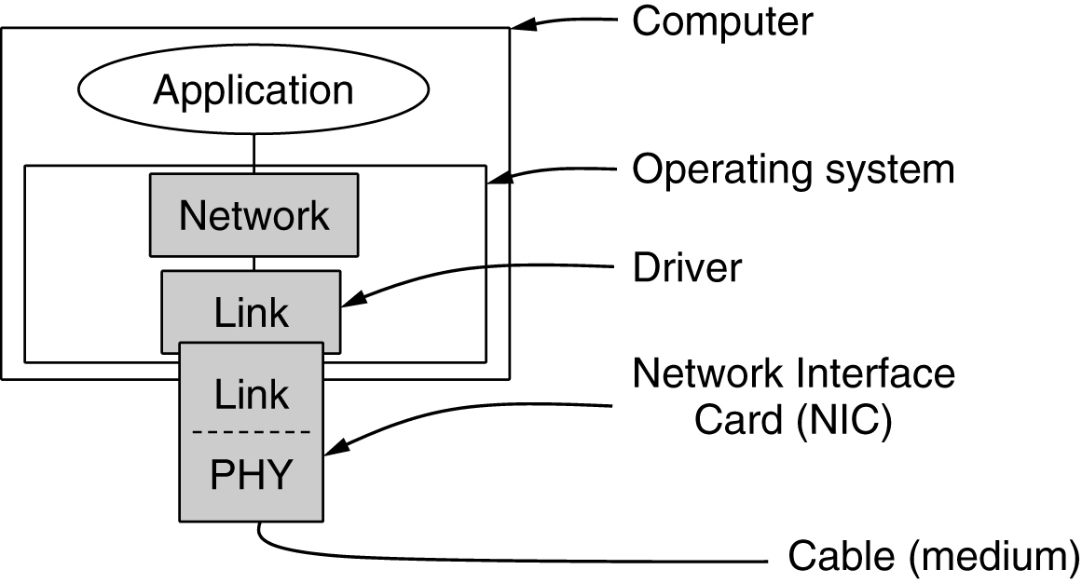
Initial Simplifying Assumptions (2 of 2)
Implementation of the physical, data link, and network layers

Slide 27
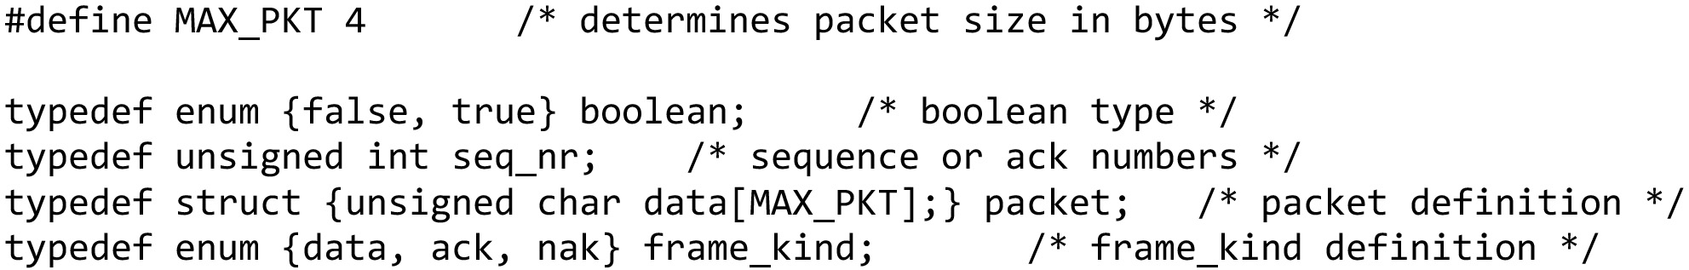
Basic Transmission And Receipt (1 of 6)
Some definitions needed in the protocols to follow. These definitions are located in the file protocol.h … continued on the next slide

Slide 28
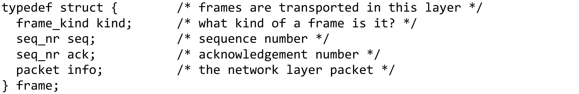
Basic Transmission And Receipt (2 of 6)
Some definitions needed in the protocols to follow. These definitions are located in the file protocol.h … continued on the next slide

Slide 29
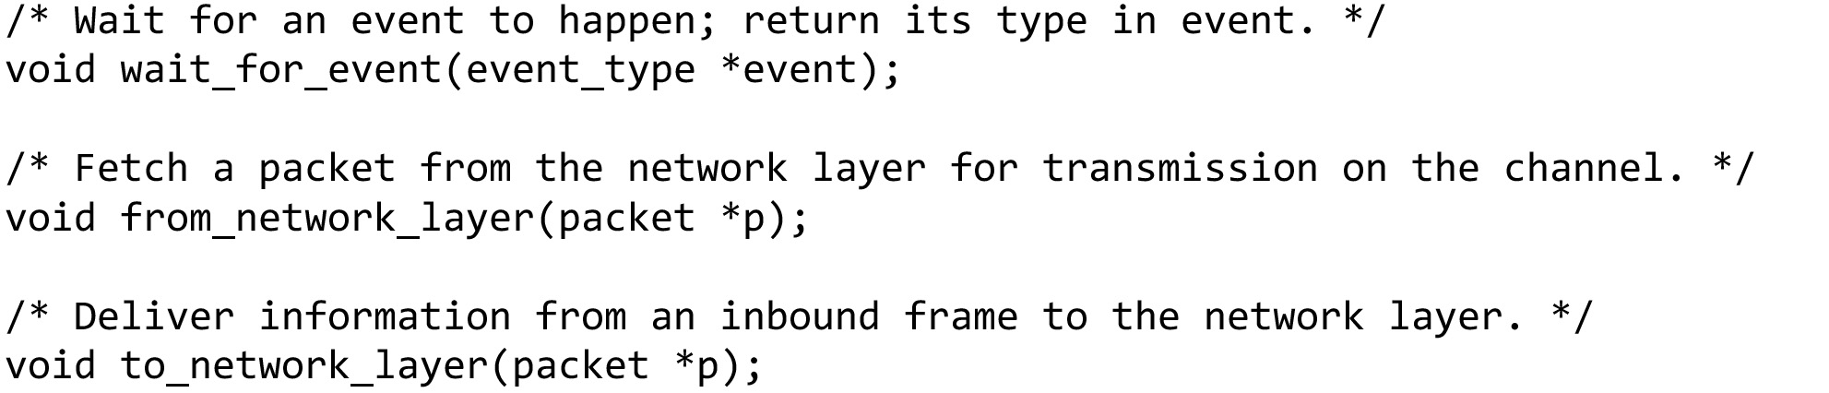
Basic Transmission And Receipt (3 of 6)
Some definitions needed in the protocols to follow. These definitions are located in the file protocol.h … continued on the next slide

Slide 30
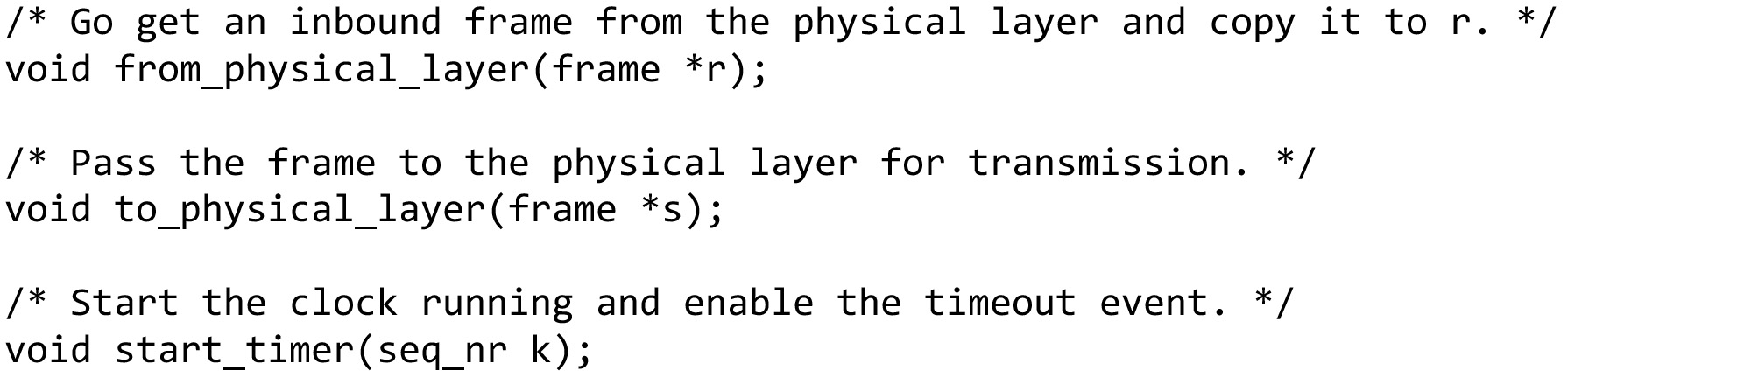
Basic Transmission And Receipt (4 of 6)
Some definitions needed in the protocols to follow. These definitions are located in the file protocol.h … continued on the next slide

Slide 31
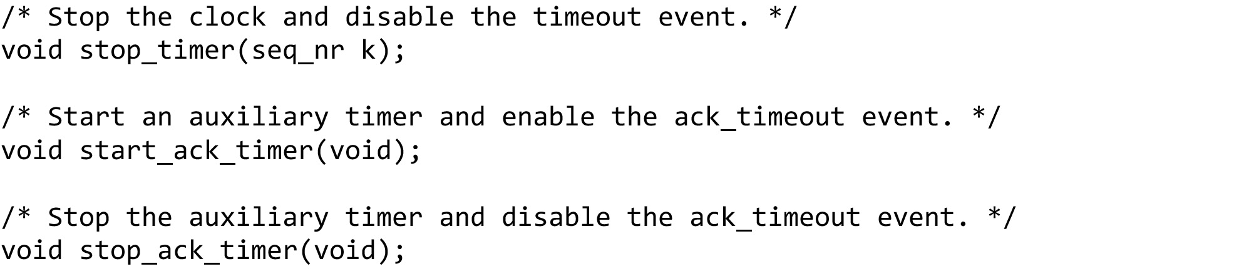
Basic Transmission And Receipt (5 of 6)
Some definitions needed in the protocols to follow. These definitions are located in the file protocol.h … continued on the next slide

Slide 32
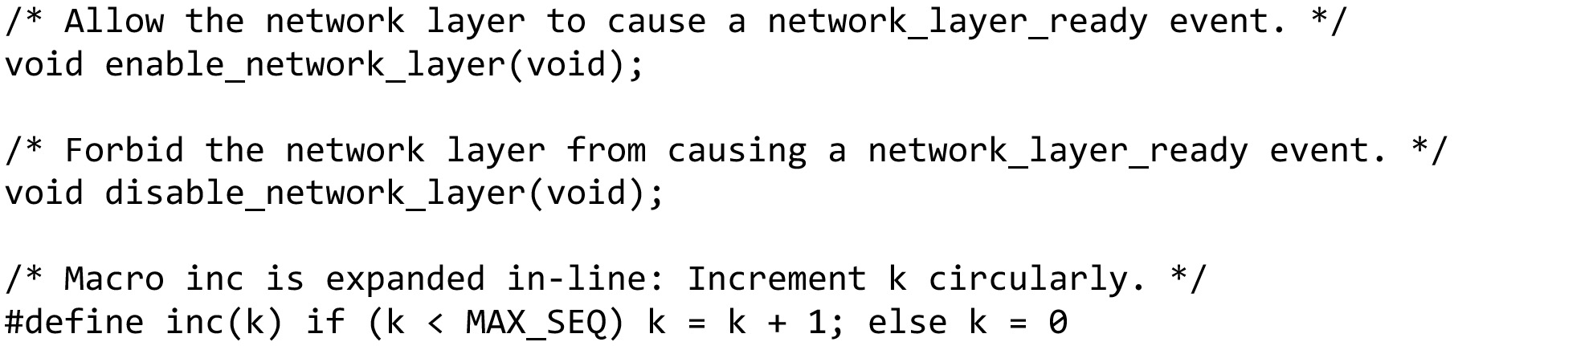
Basic Transmission And Receipt (6 of 6)
Some definitions needed in the protocols to follow. These definitions are located in the file protocol.h (end of code)

Slide 33
Simplex Link-Layer Protocols (1 of 10)
Utopia: No Flow Control or Error Correction
Adding Flow Control: Stop-and-Wait
Adding Error Correction: Sequence Numbers and ARQ

Slide 34
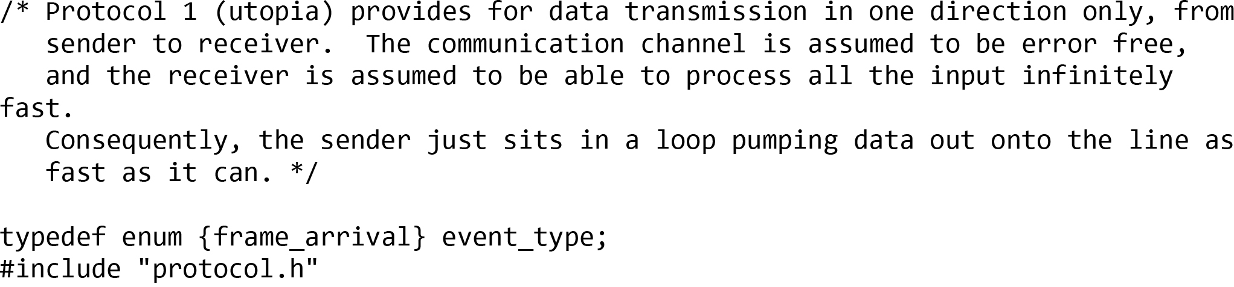
Simplex Link-Layer Protocols (2 of 10)
Utopia: No Flow Control or Error Correction
A utopian simplex protocol … continued on the next slide

Slide 35
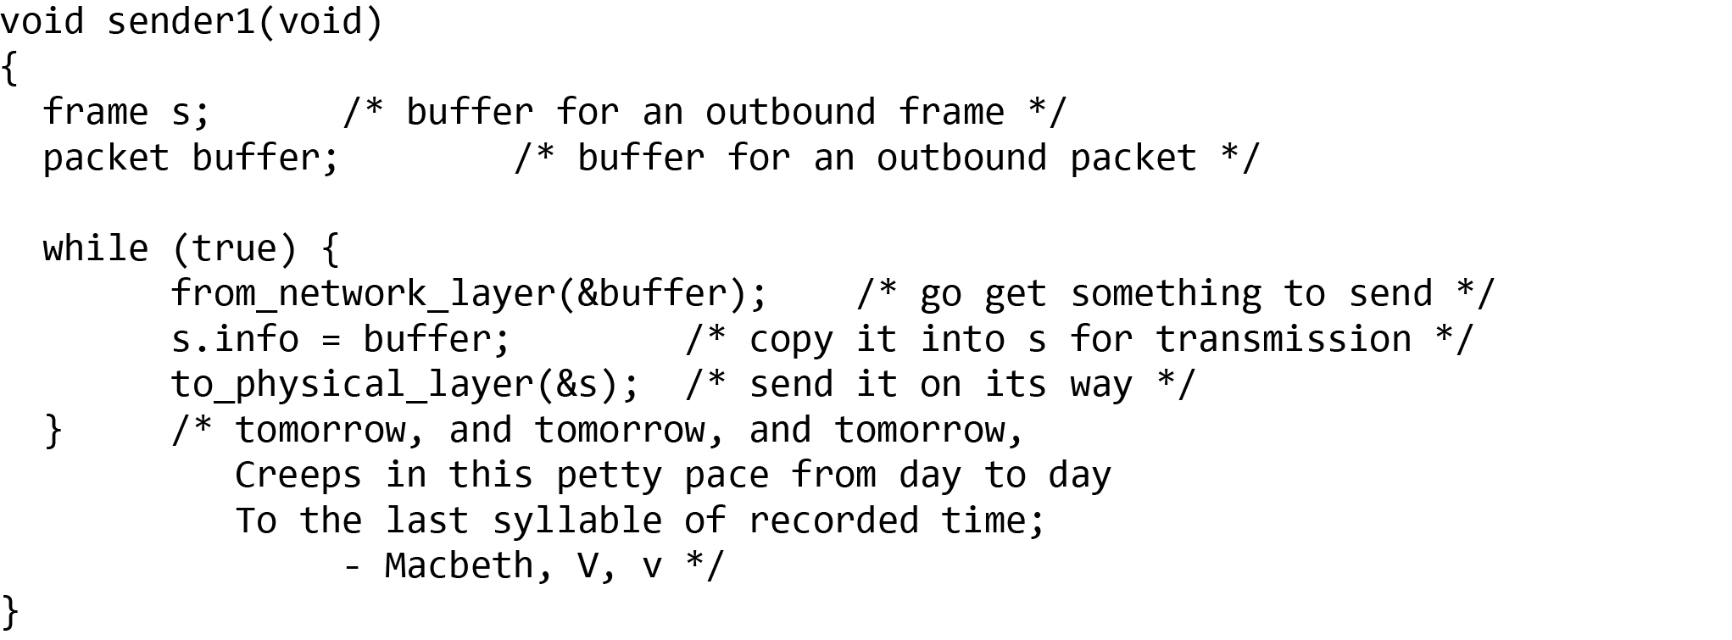
Simplex Link-Layer Protocols (3 of 10)
Utopia: No Flow Control or Error Correction
A utopian simplex protocol … continued on the next slide

Slide 36
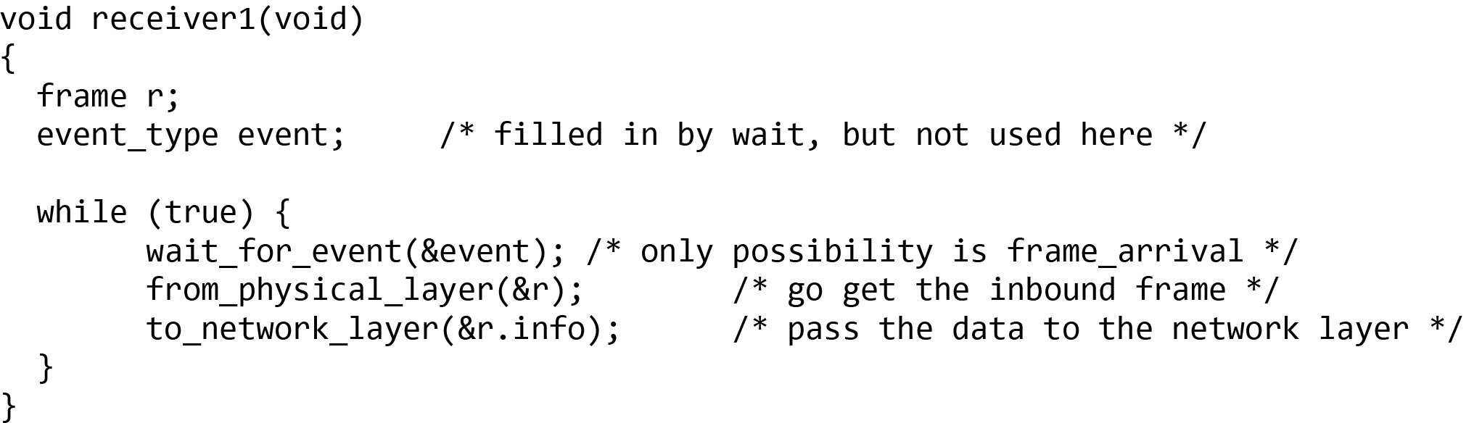
Simplex Link-Layer Protocols (4 of 10)
Utopia: No Flow Control or Error Correction
A utopian simplex protocol (end of code)

Slide 37
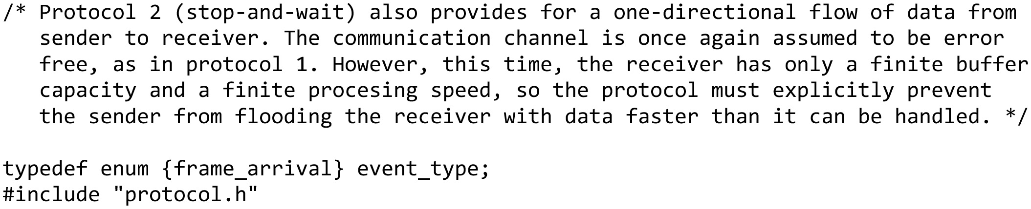
Simplex Link-Layer Protocols (5 of 10)
Adding Flow Control: Stop-and-Wait
A simplex stop-and-wait protocol … continued on the next slide

Slide 38
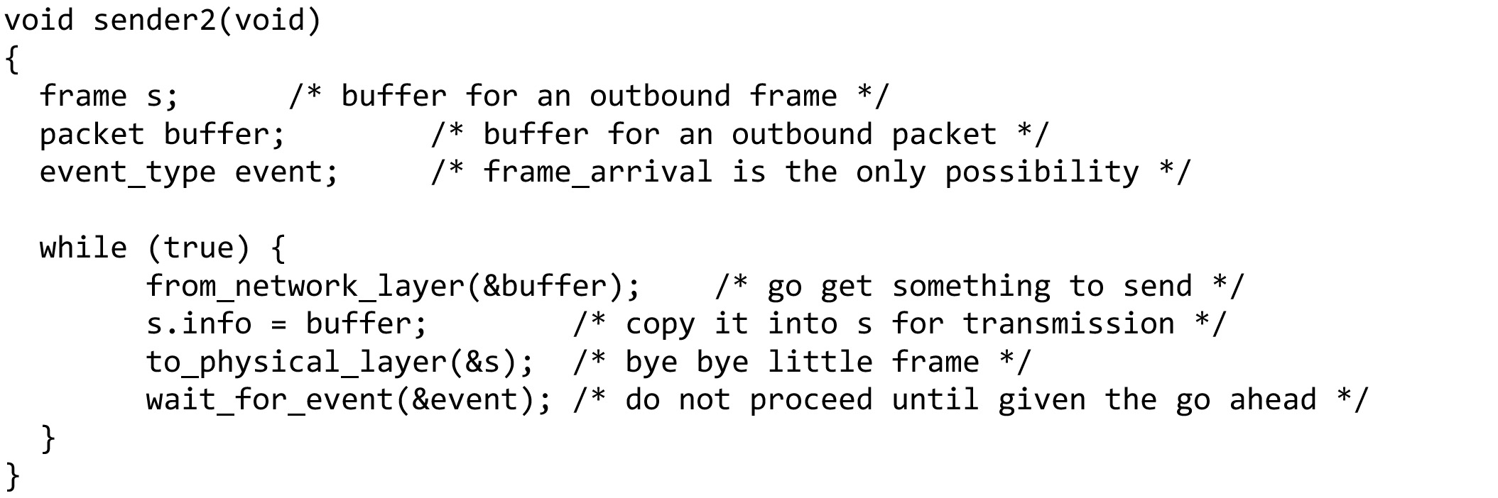
Simplex Link-Layer Protocols (6 of 10)
Adding Flow Control: Stop-and-Wait
A simplex stop-and-wait protocol … continued on the next slide

Slide 39
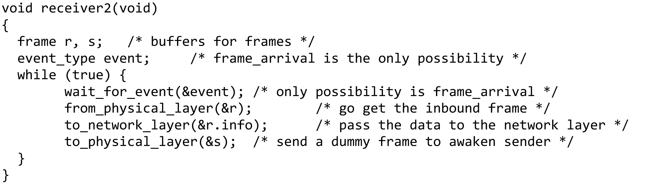
Simplex Link-Layer Protocols (7 of 10)
Adding Flow Control: Stop-and-Wait
A simplex stop-and-wait protocol (end of code)

Slide 40
Consider the following scenario:
The network layer on A gives packet 1 to its data link layer. The packet is correctly received at B and passed to the network layer on B. B sends an acknowledgement frame back to A.
The acknowledgement frame gets lost completely. It just never arrives at all. Life would be a great deal simpler if the channel mangled and lost only data frames and not control frames, but sad to say, the channel is not very discriminating.
The data link layer on A eventually times out. Not having received an acknowledgement, it (incorrectly) assumes that its data frame was lost or damaged and sends the frame containing packet 1 again.
The duplicate frame also arrives intact at the data link layer on B and is unwittingly passed to the network layer there. If A is sending a file to B, part of the file will be duplicated (i.e., the copy of the file made by B will be incorrect and the error will not have been detected). In other words, the protocol will fail.

Slide 41
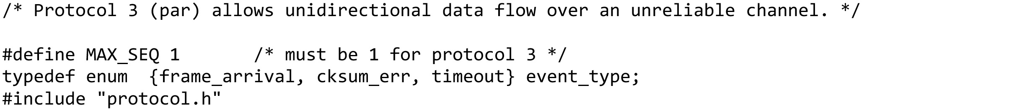
Simplex Link-Layer Protocols (8 of 10)
Adding Error Correction: Sequence Numbers and ARQ
A positive acknowledgement with retransmission protocol … continued on the next slide

Slide 42
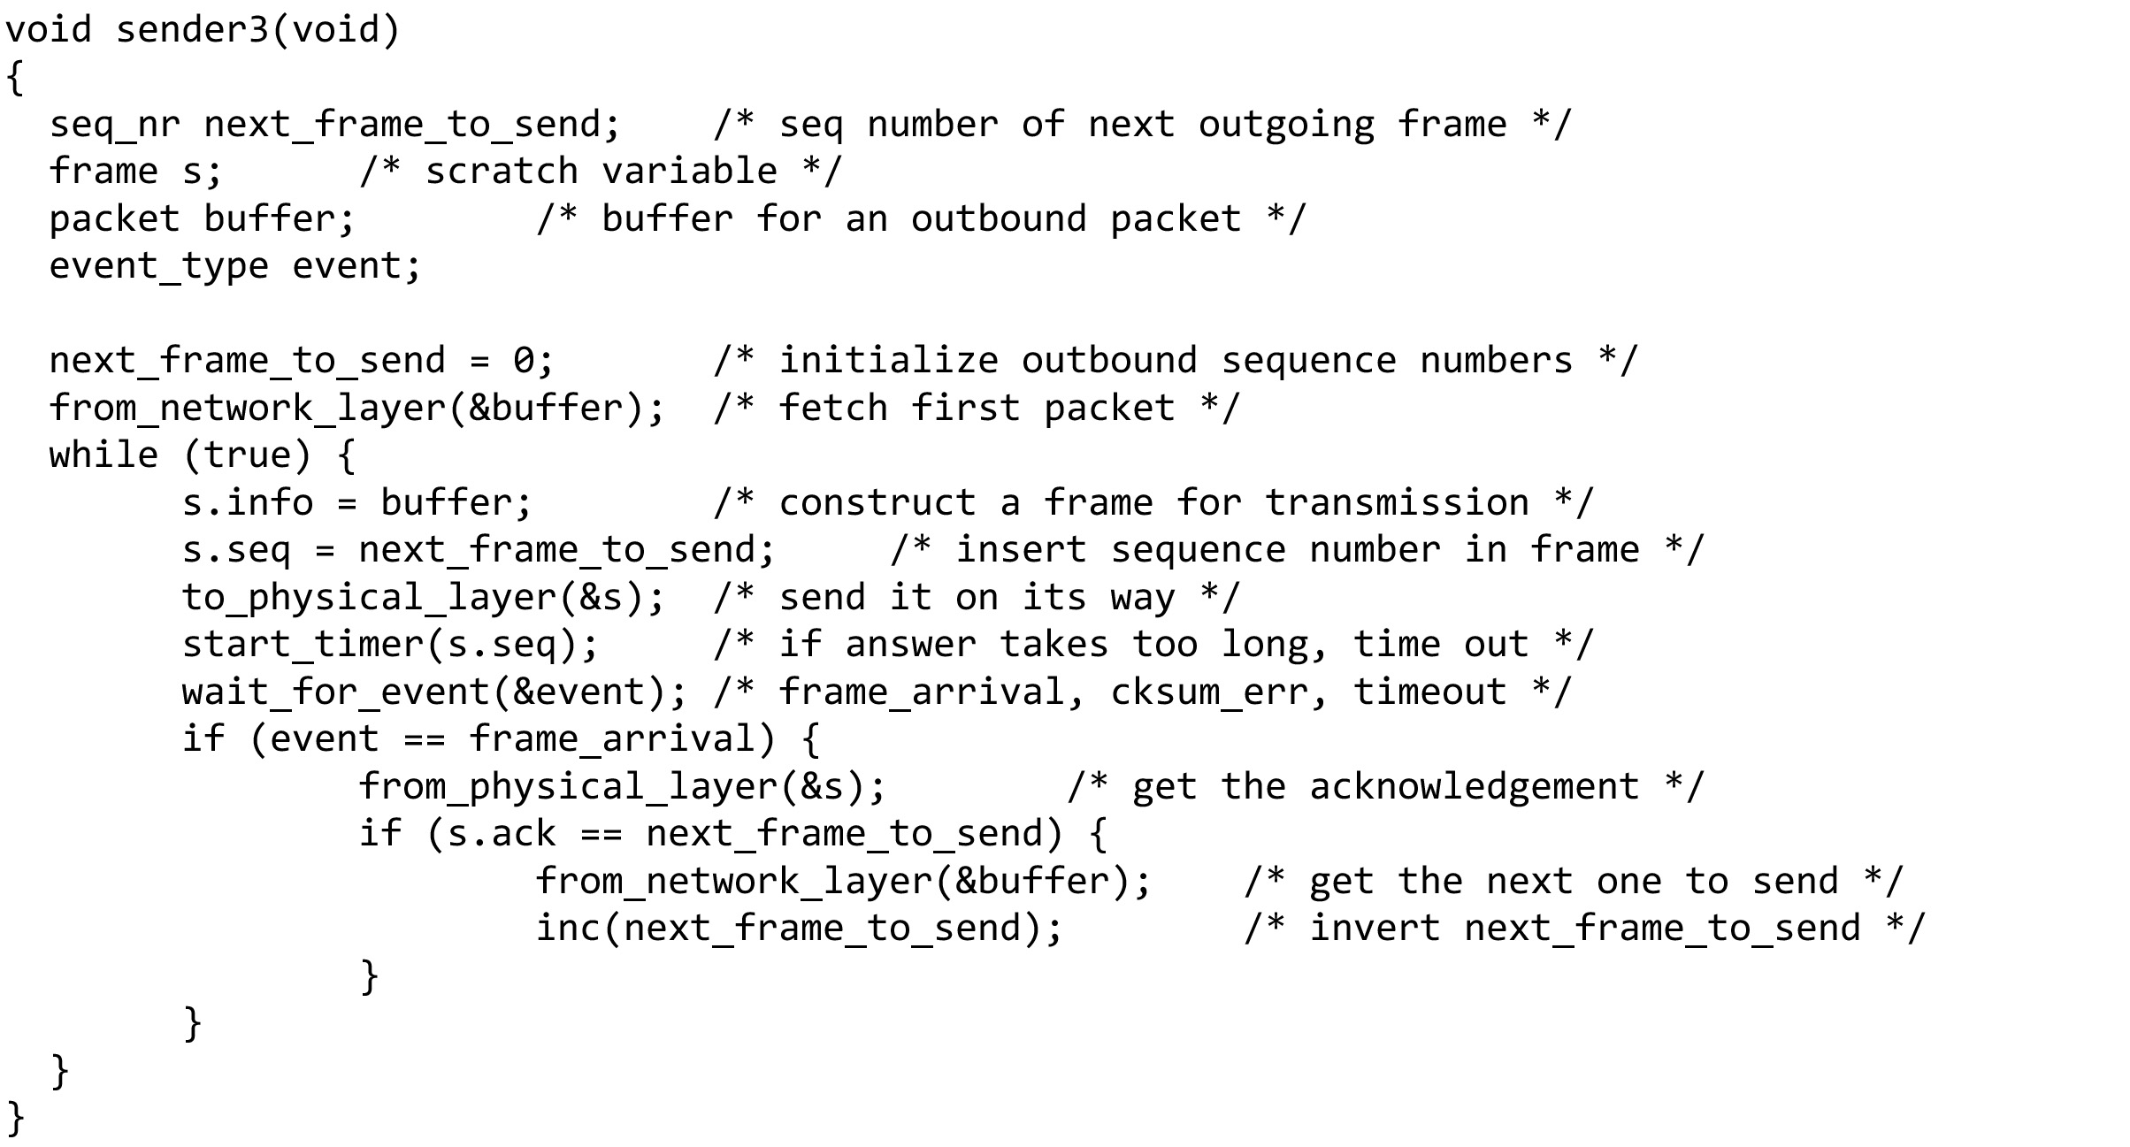
Simplex Link-Layer Protocols (9 of 10)
Adding Error Correction: Sequence Numbers and ARQ
A positive acknowledgement with retransmission protocol … continued on the next slide

Slide 43
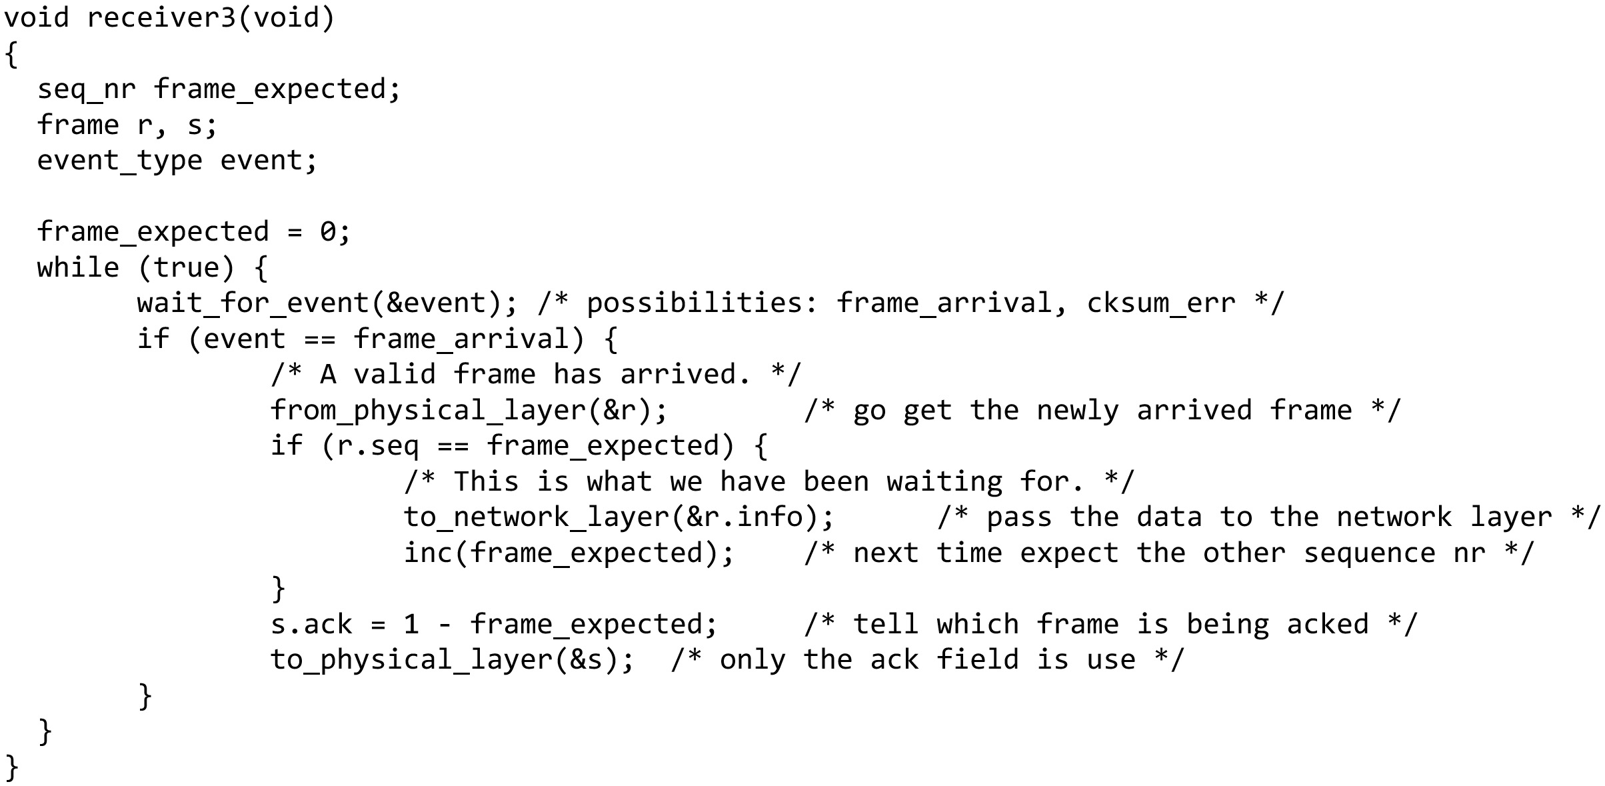
Simplex Link-Layer Protocols (10 of 10)
Adding Error Correction: Sequence Numbers and ARQ
A positive acknowledgement with retransmission protocol (end of code)

Slide 44
Questions for you
Utopia: No Flow Control or Error Correction
-When should we use Utopia?
Adding Flow Control: Stop-and-Wait
-How it works?
Adding Error Correction: Sequence Numbers and ARQ
-Why we use sequence number?
How bidirectional transmission works?
What is piggybacking?

Slide 45
Improving Efficiency
Need bidirectional data transmission
Link layer efficiency improvement
Send multiple frames simultaneously before receiving an acknowledgement

Slide 46
Bidirectional Transmission, Multiple Frames in Flight (1 of 3)
Bidirectional transmission: piggybacking
Use the same link for data in both directions
Interleave data and control frames on the same link
Temporarily delay outgoing acknowledgements so they can be hooked onto the next outgoing data frame
Piggybacking advantages
A better use of the available channel bandwidth
Lighter processing load at the receiver
Piggybacking issue
Determining time data link layer waits for a packet to piggyback the acknowledgement

Slide 47
Bidirectional Transmission, Multiple Frames in Flight (2 of 3)
Three bidirectional sliding window protocols
One-bit sliding window, go-back-n, selective repeat
Consider any instant of time
Sender maintains a set of sequence numbers corresponding to frames it is permitted to send
Frames are said to fall within the sending window
Receiver maintains a receiving window corresponding to the set of frames it is permitted to accept
Differ among themselves in terms of efficiency, complexity, and buffer requirements

Slide 48
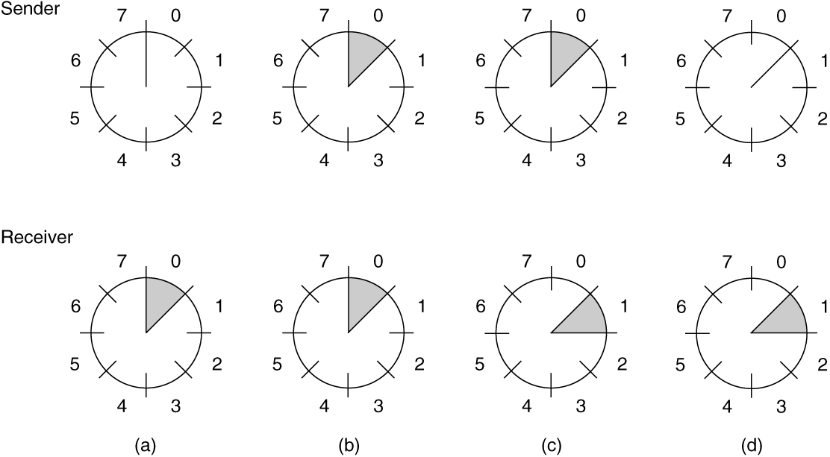
Bidirectional Transmission, Multiple Frames in Flight (3 of 3)
A sliding window of size 1, with a 3-bit sequence number. (a) Initially. (b) After the first frame has been sent. (c) After the first frame has been received. (d) After the first acknowledgement has been received.

Slide 49
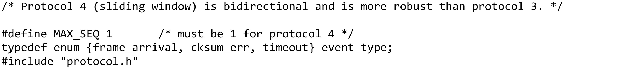
Examples (1 of 20)
A 1-bit sliding window protocol … continued on the next slide

Slide 50
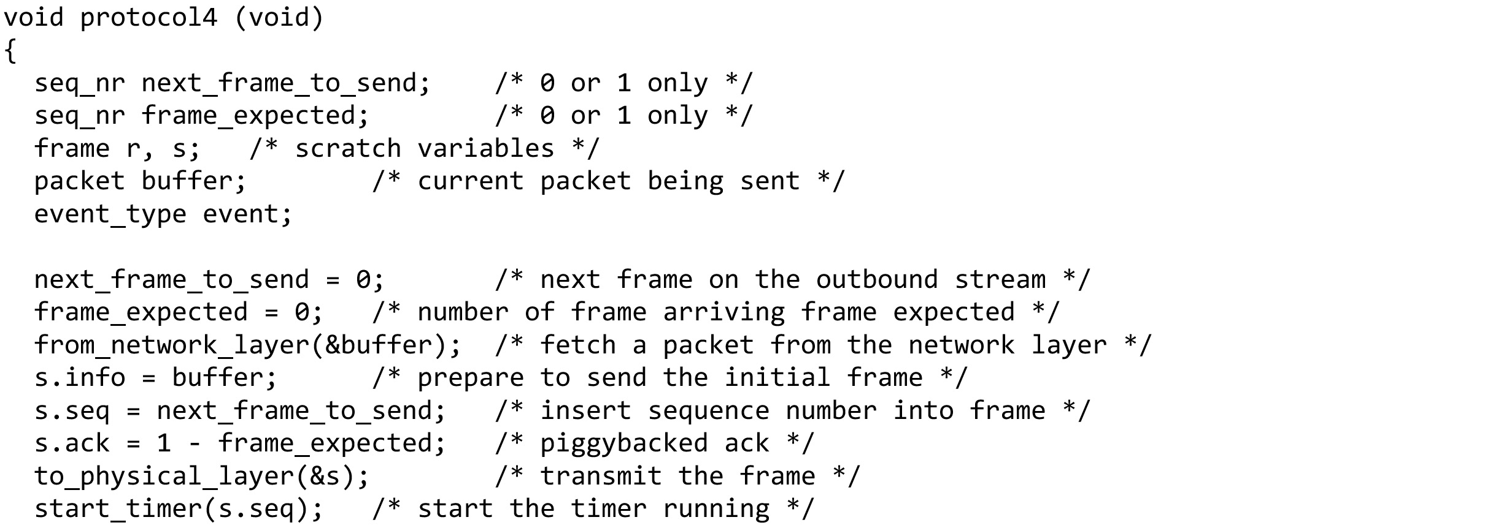
Examples (2 of 20)
A 1-bit sliding window protocol … continued on the next slide

Slide 51
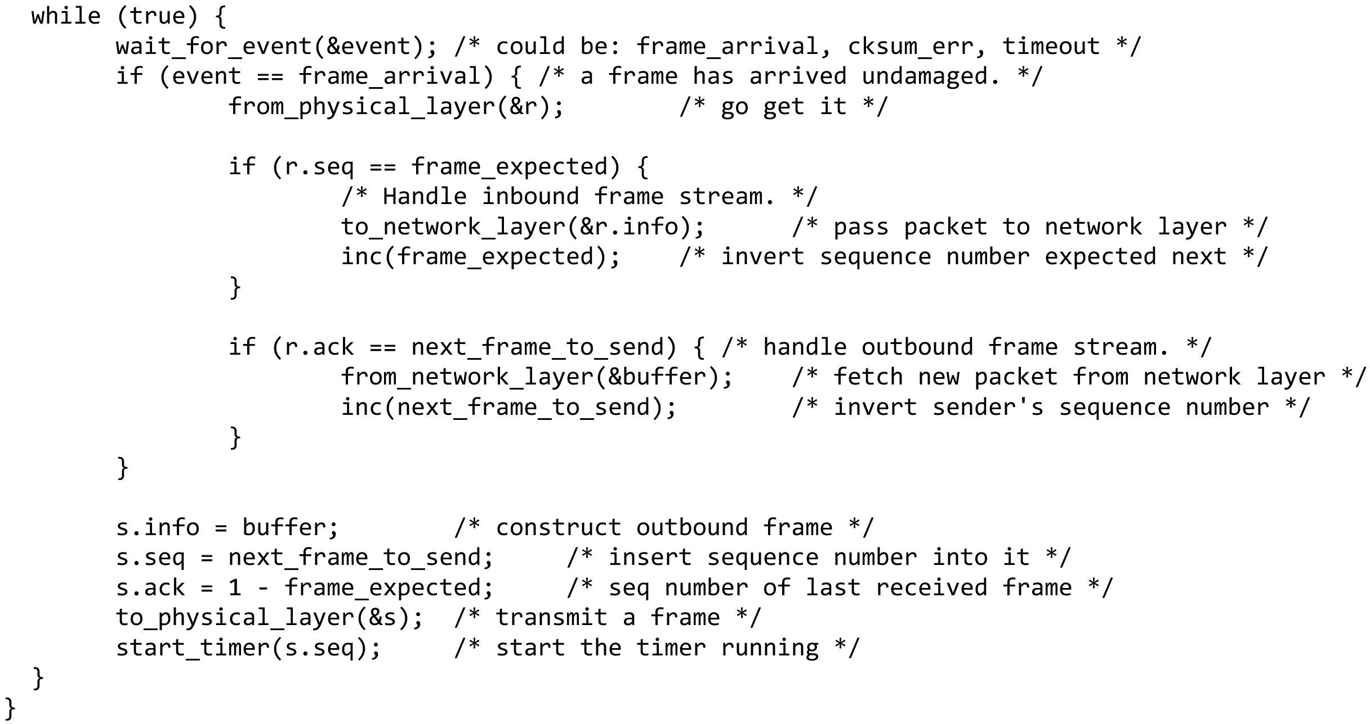
Examples (3 of 20)
A 1-bit sliding window protocol (end of code)

Slide 52
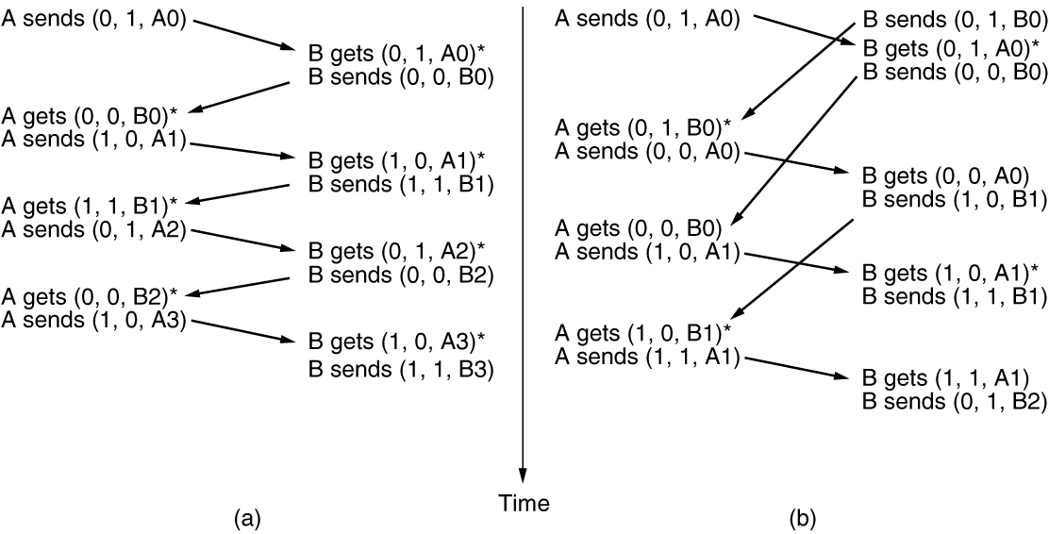
Examples (4 of 20)
Two scenarios for protocol 4. (a) Normal case. (b) Abnormal case. The notation is (seq, ack, packet number). An asterisk indicates where a network layer accepts a packet.

Slide 53
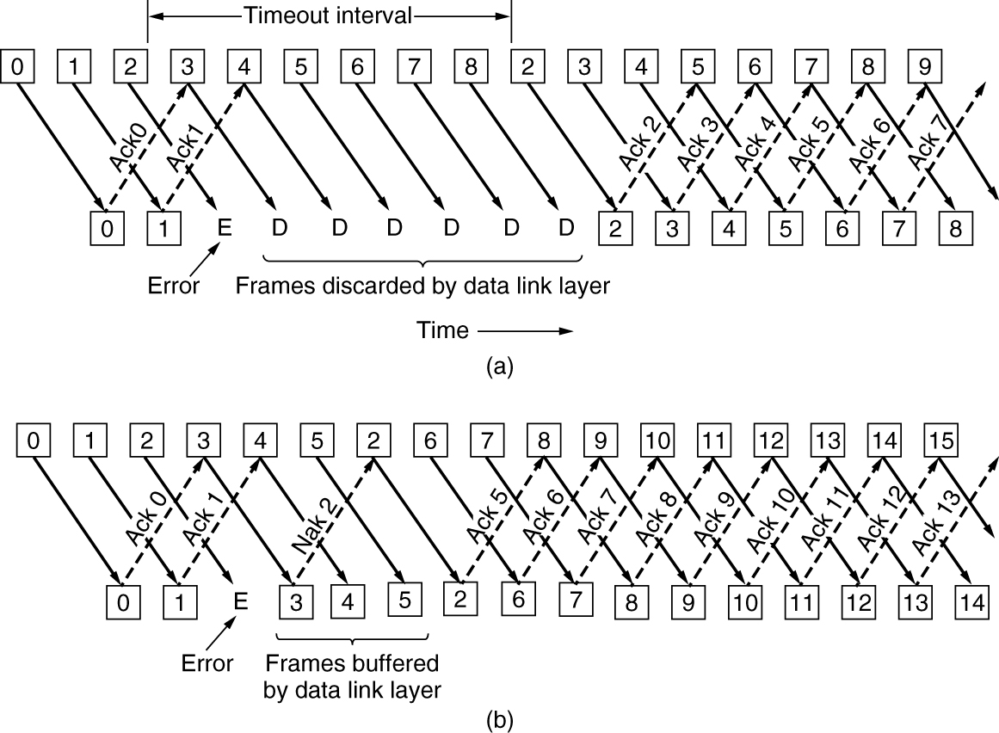
Examples (5 of 20)
go-back-n
selective repeat
Pipelining and error recovery.

Slide 54
Questions for you
Three bidirectional sliding window protocols
One-bit sliding window
go-back-n
selective repeat

Slide 55
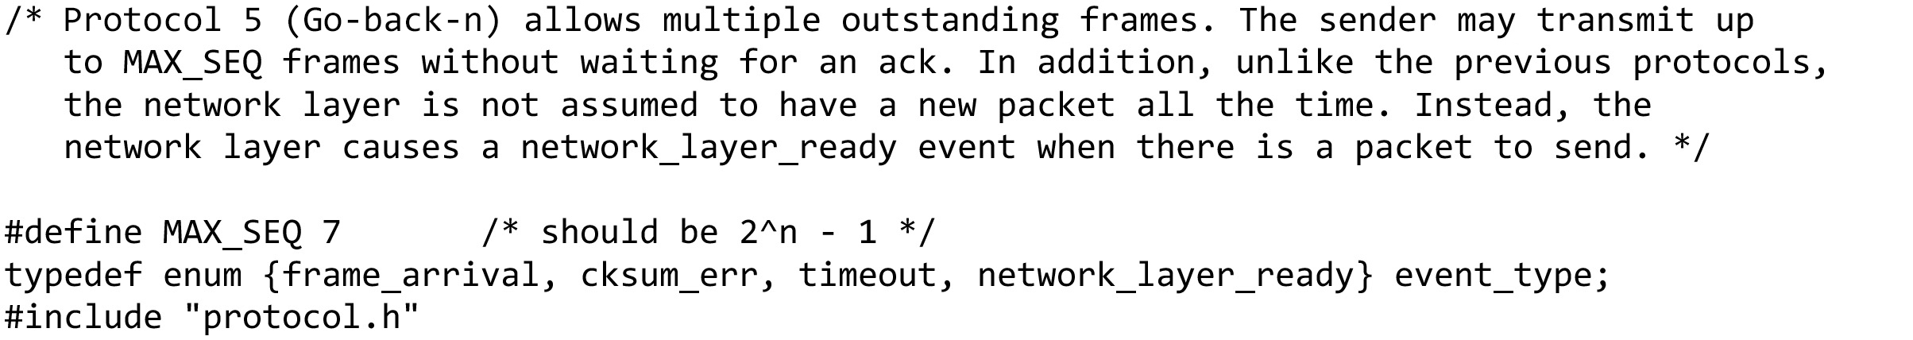
Examples (6 of 20)
A sliding window protocol using go-back-n … continued on the next slide

Slide 56
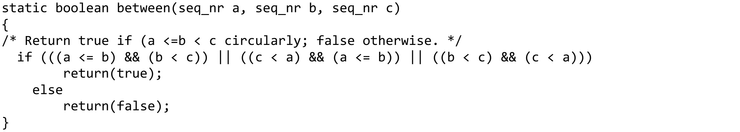
Examples (7 of 20)
A sliding window protocol using go-back-n … continued on the next slide

Slide 57
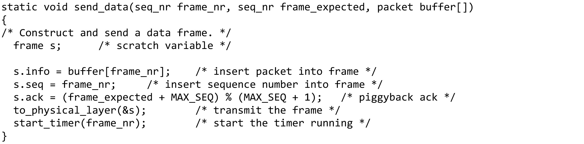
Examples (8 of 20)
A sliding window protocol using go-back-n … continued on the next slide

Slide 58
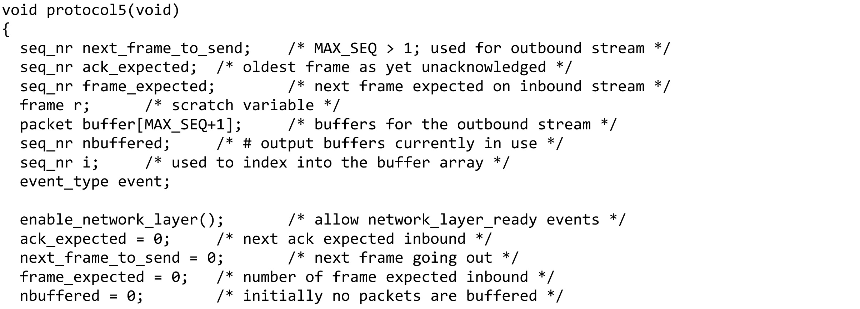
Examples (9 of 20)
A sliding window protocol using go-back-n … continued on the next slide

Slide 59
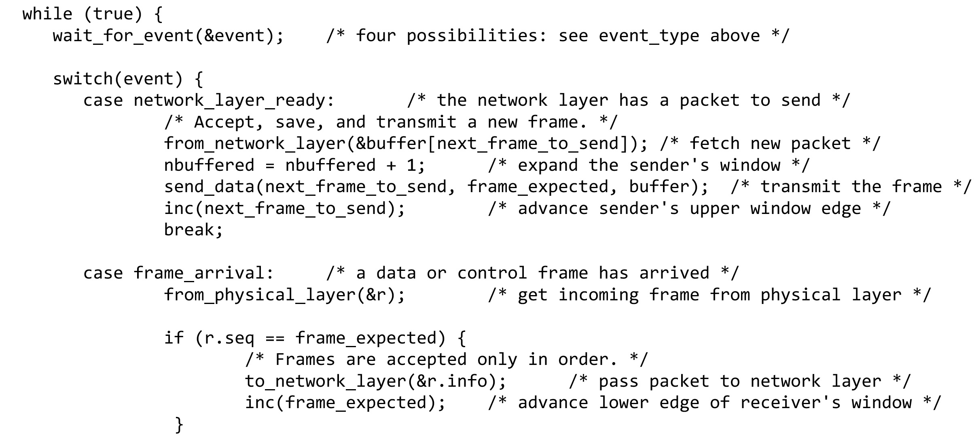
Examples (10 of 20)
A sliding window protocol using go-back-n … continued on the next slide

Slide 60
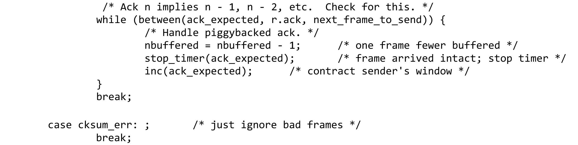
Examples (11 of 20)
A sliding window protocol using go-back-n … continued on the next slide

Slide 61
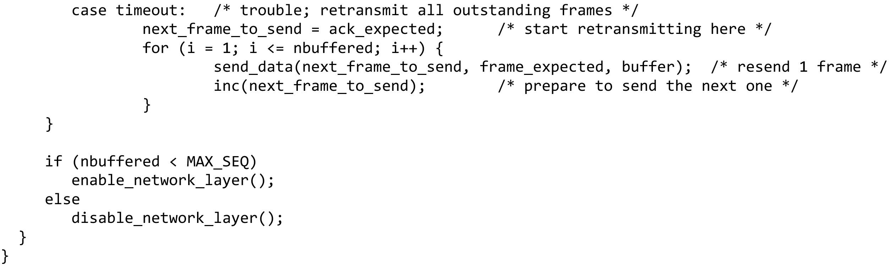
Examples (12 of 20)
A sliding window protocol using go-back-n (end of code)

Slide 62
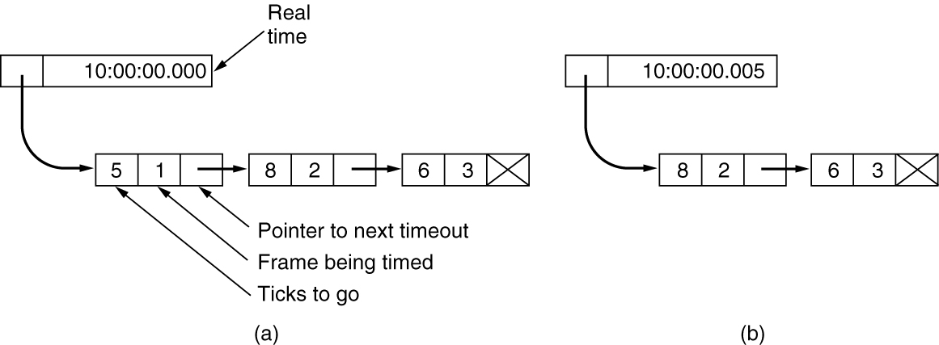
Examples (13 of 20)
Simulation of multiple timers in software. (a) The queued timeouts. (b) The situation after the first timeout has expired.

Slide 63
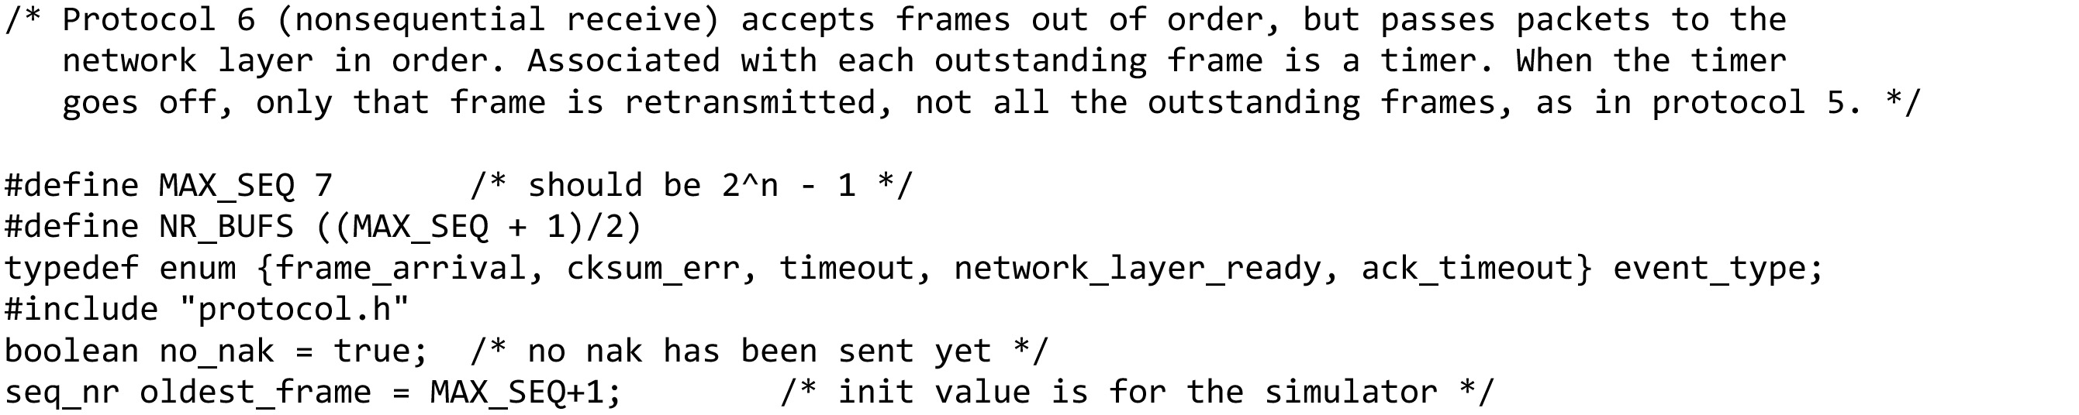
Examples (14 of 20)
A sliding window protocol using selective repeat … continued on the next slide

Slide 64
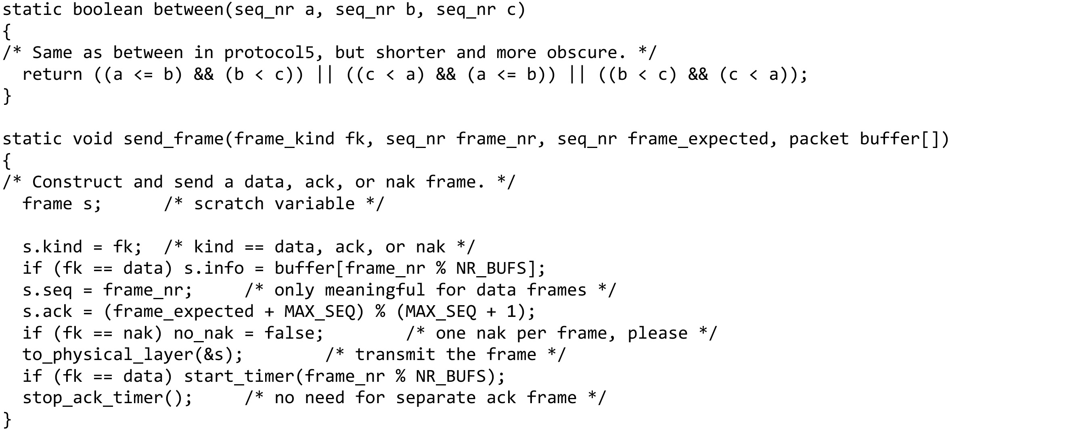
Examples (15 of 20)
A sliding window protocol using selective repeat … continued on the next slide

Slide 65
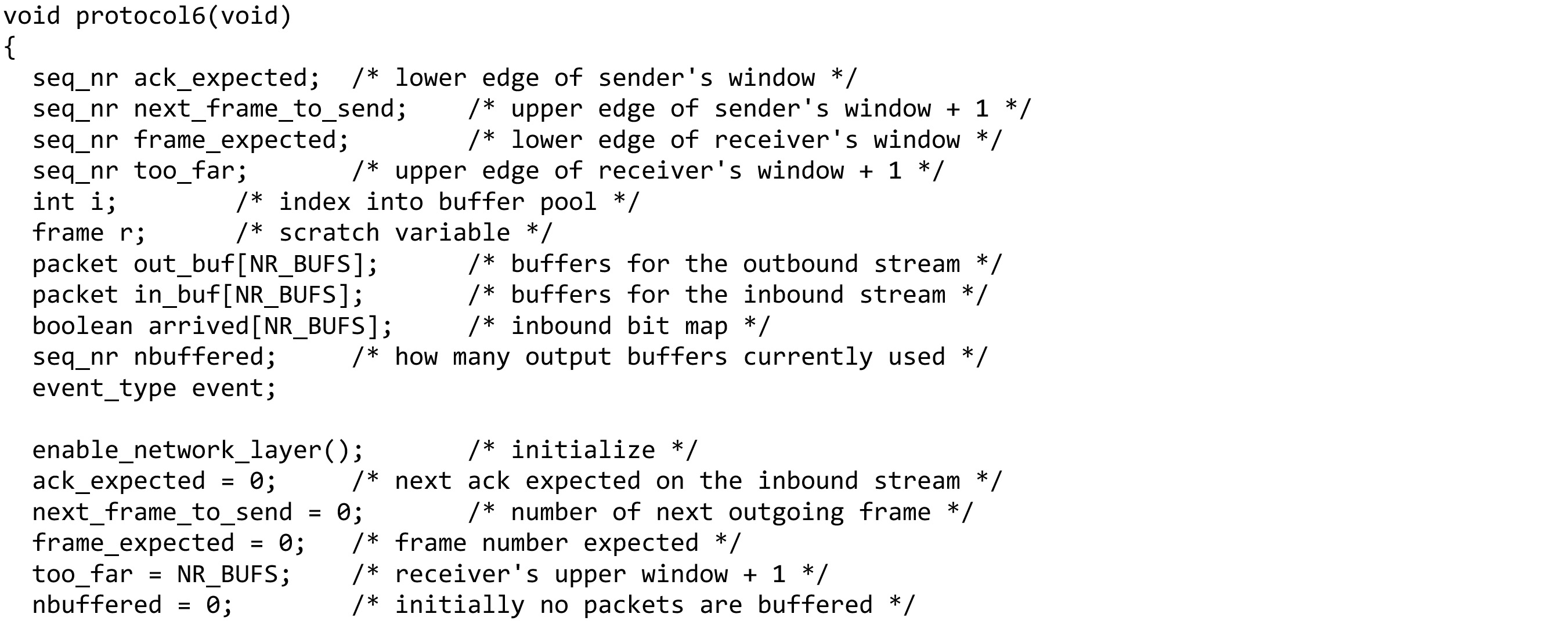
Examples (16 of 20)
A sliding window protocol using selective repeat … continued on the next slide

Slide 66
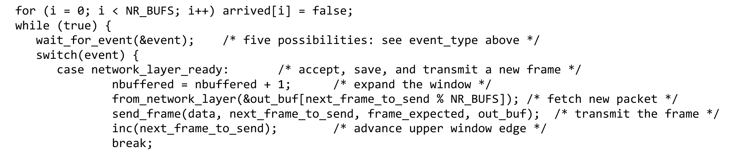
Examples (17 of 20)
A sliding window protocol using selective repeat … continued on the next slide

Slide 67
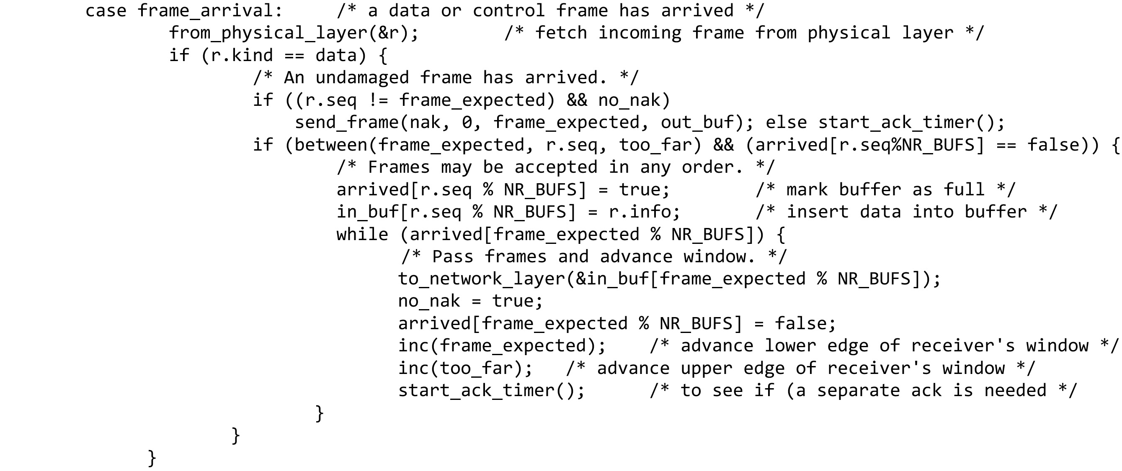
Examples (18 of 20)
A sliding window protocol using selective repeat … continued on the next slide

Slide 68
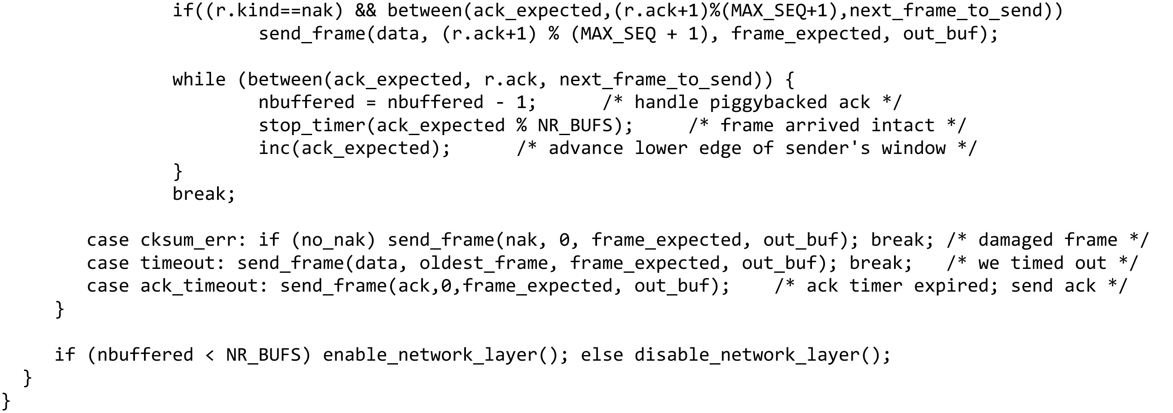
Examples (19 of 20)
A sliding window protocol using selective repeat (end of code)

Slide 69
Data Link Protocols in Practice
Packet over SONET
ADSL (Asymmetric Digital Subscriber Loop)

Slide 70
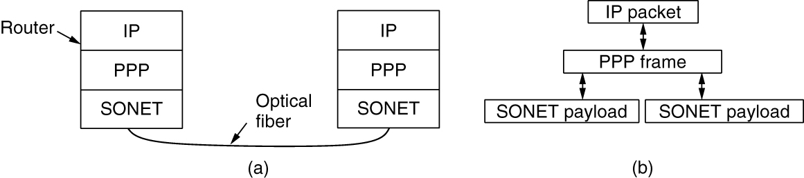
Packet over SONET (1 of 4)
Point-to-point protocol
Packet over SONET. (a) A protocol stack. (b) Frame relationships.

Slide 71
Packet over SONET (2 of 4)
PPP (Point-to-Point Protocol) features
Separate packets, error detection
Link Control Protocol (LCP)
Network Control Protocol (NCP)

Slide 72
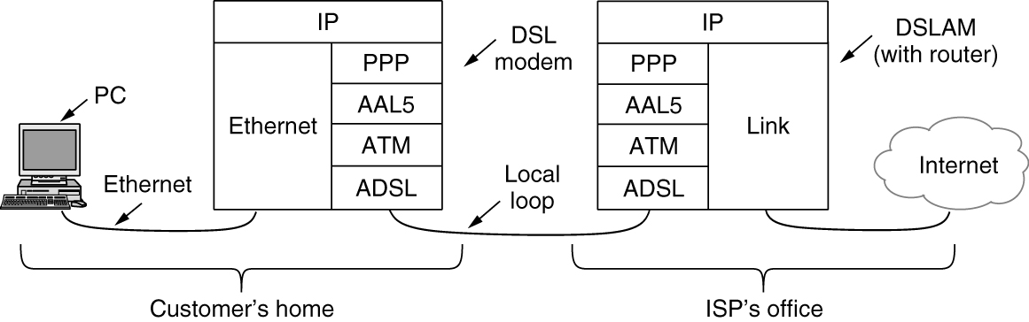
ADSL (1 of 2)
ADSL protocol stacks

Slide 73

Copyright
This work is protected by United States copyright laws and is provided solely for the use of instructors in teaching their courses and assessing student learning. Dissemination or sale of any part of this work (including on the World Wide Web) will destroy the integrity of the work and is not permitted. The work and materials from it should never be made available to students except by instructors using the accompanying text in their classes. All recipients of this work are expected to abide by these restrictions and to honor the intended pedagogical purposes and the needs of other instructors who rely on these materials.

